Slide 1
Introduction to scRNA-Seq data analysis Bioinformatics mini-series part I brought to you by BABS
Phil East
BABS (Bioinformatics & Biostatistics)
NE316

Slide 2
Bioinformatics mini-series
Part1: An Introduction to scRNA-Seq Data Analysis.
Part2: Ordering Cells: Pseudo-time and Trajectory Building
16th September Richard Mitter
Future instalments
Data Integration across multiple sets of cells
Cell Characterisation and Atlas Datasets
scATAC-Seq Analysis
Correcting for systematic effects
Notes:
We already have part II. Richard Mitter is going to cover Pseudo-time analysis and we have these possible future topics lined up.

Slide 3
News
Sarah Teichmann on Radio 4’s Today Programme 18th Feb.
Human Cell Atlas – Google Map the human body.
https://www.bbc.co.uk/sounds/play/m000fgcj 2:42:00

Slide 4
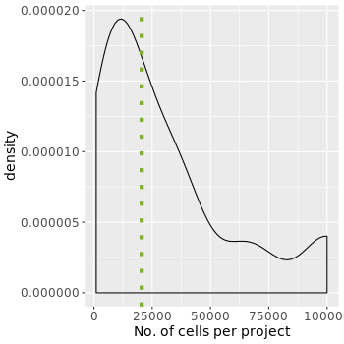
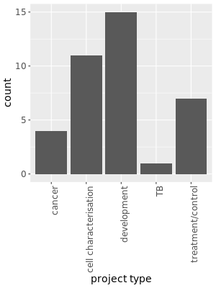
scRNA-Seq in BABS
48 Single cell projects
Cell count per project

Slide 5
scRNA-Seq analysis overview
Integration (optional)
Quantification
QC
Data processing
QC
Biology
Alignment
Deconvolution
Cell / UMI
barcodes
Quantification
Cell count
Gene count
Read count
Signal to noise
Saturation
Normalisation
Feature selection
Dimension reduction
Clustering
t-SNE/UMAP
Low count cells
Doublets
Mitochondrial
Cell characterisation
Differential analysis
Notes:
This is an overview of the analysis process. We have quantification or the construction of the expression matrix across cells, we have a QC step, we then have an optional integration step if you are working with multiple libraries, we then have data processing where standard analysis steps are applied, further QC and then finally onto answering the biological question at hand.

Slide 6
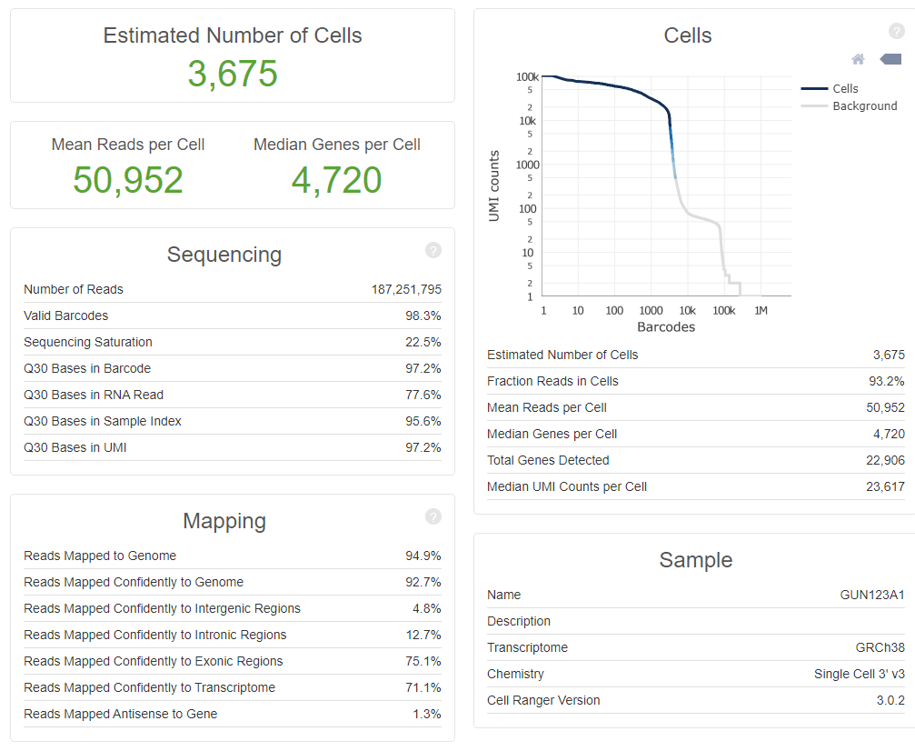
Quantification
Quantification
QC
Data processing
QC
Biology
integration
Alignment
Cell and molecule deconvolution
Transcriptome quantification
QC metrics
Cell calling
Cellranger QC report
Notes:
This involves the alignment of the reads, the deconvolution of the cell and molecular barcodes, the quantification of the genes, the generation of some QC metrics. Now this is a cellranger report that contains many metrics, five of these are important. The cell calling where we want to identify the good quality cell transcriptomes from the empty droplets and we do this using this graph here..

Slide 7
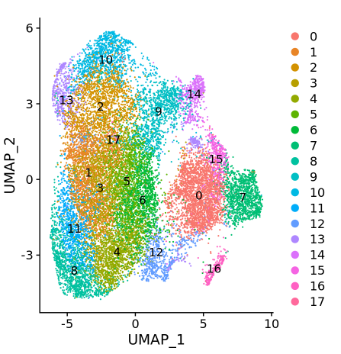
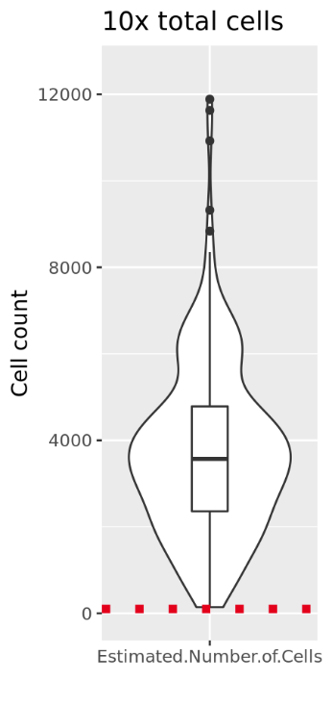
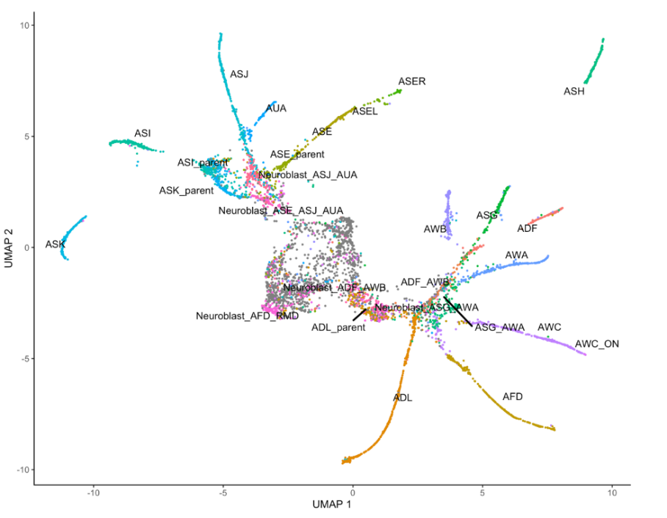
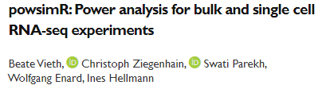
Number of cells
Quantification
QC
Data processing
QC
Biology
integration
ASF aim for 4,000
What is a good number?
Heterogeneity of your cell population.
Representation of your cell type of interest.
Trajectory resolution.
Enrich with FACS.
You won’t know until you have analysed the data.
Cell type dependent selection.
Stability of cells is cell type dependent.
Power calculation
https://satijalab.org/howmanycells
Notes:
The resolution required to build trajectories if you are interested in carrying out pseudo-time analysis.
Not all cells have equal chance of making it into the library. There are cell type dependent selection effects with droplet technologies and the stability of the cells in suspension will depend on the cell type as well.

Slide 8
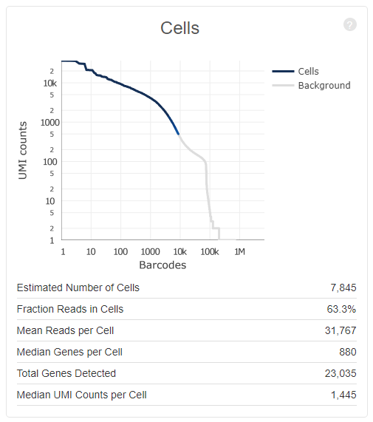
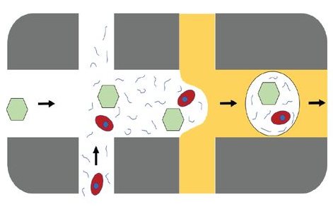
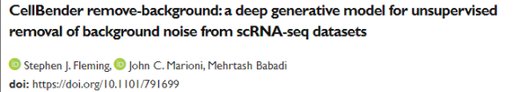
Cell Viability: Number of reads in cells
Quantification
QC
Data processing
QC
Biology
integration
Cell death
Lysis
Ambient RNA
Pervasive.
Dilutes the true transcriptome signal.
Poor cell calling.
Many low count cells called as good cells
Reduced power to detect cell transcripts.
Low gene count
Cell characterisation.
Differential analysis.
Trajectory building.
Notes:
Another important metric is the fraction of reads in cells which is an effective measure of cell viability. Poor cell viability means a lot of cell death, which means a lot of lysis and a lot of ambient RNA. This ambient RNA is a problem in the analysis.

Slide 9
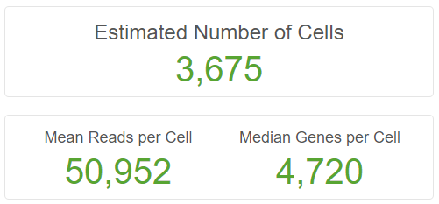
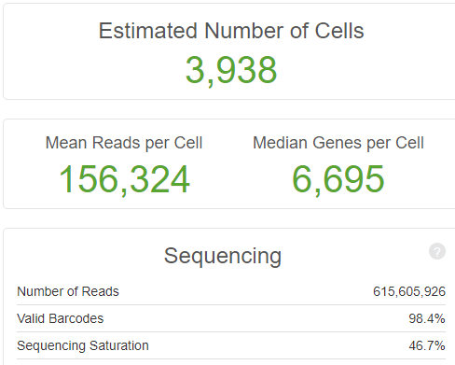
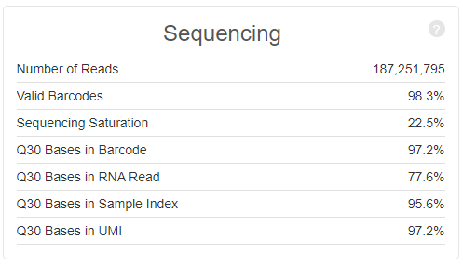
Saturation
Quantification
QC
Data processing
QC
Biology
integration
How much of the transcriptional signal you have sampled.
Cost
More cells with less sequencing

Slide 10
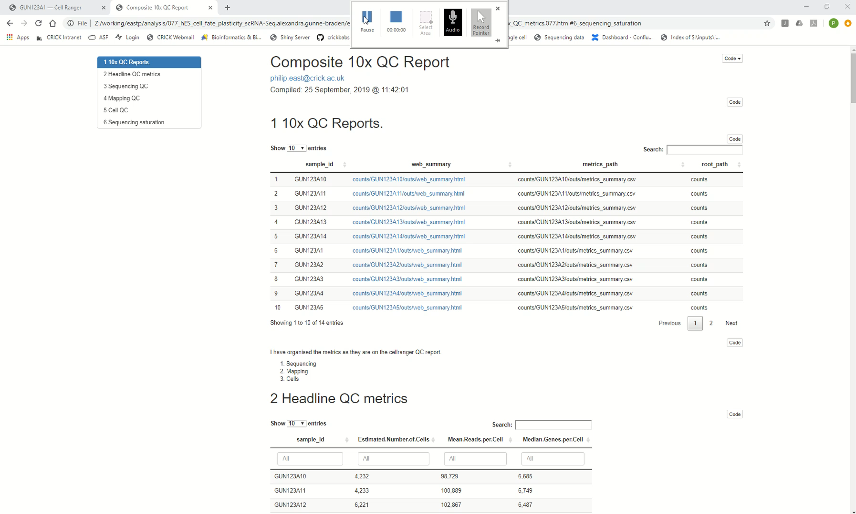
Merged Cellranger reports
Quantification
QC
Data processing
QC
Biology
integration
Notes:
Many single cell experiments are made up of multiple 10x libraries all producing their own 10 report and these can be difficult to disgest so we have written a tool to compile multiple reports.

Slide 11


Analysing the data – Data processing
Quantification
QC
Data processing
QC
Biology
integration
https://satijalab.org/seurat/vignettes.html
Read in data.
Seurat data object.
Normalisation.
Feature selection.
Dimension reduction.
Clustering.
tSNE / diffusion maps.

Slide 12
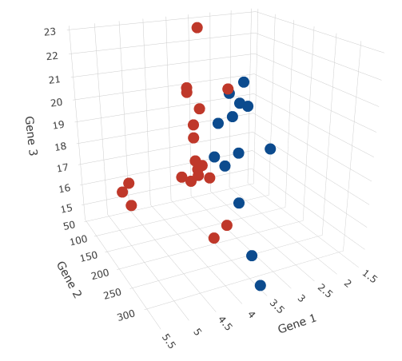
The data
Quantification
QC
Data processing
QC
Biology
integration
Cell space
Highly dimensional
33538 (genes) x 4000 (cells)
Sparse
82% zeros
Notes:
This is a matrix from a human cell set. Where the axes are the genes and where the cells sit in this space depends on the activity of their transcriptome. Proximity means similarity.

Slide 13
Reading the data
Quantification
QC
Data processing
QC
Biology
integration
path_to_cellranger_matrix <- “counts/GUN123A1/outs/filtered_feature_bc_matrix”
data_10x <- Read10X( data.dir = path_to_cellranger_matrix )
srat_obj <- CreateSeuratObject( counts = data_10x,
project = s,
min.cells = 0,
min.features = 200 )
min.cells : The minimum number of cells a gene should be detected in.
min.features : The minimum number of detectable genes a cell should have.
Set min.cells = 0 to get all genes. This is important if you want to integrate datasets later on.
Notes:
Min.cells is the gene filter which removes genes that are expressed in less than the defined number of cells and min.feature is the cell filter that removes cells with less than the defined number of detected genes.

Slide 14
Data normalisation
Quantification
QC
Data processing
QC
Biology
integration
UMI expression counts are scaled to 1e5 reads and log transformed.
Z-score normalise each gene across all cells.
srat_obj <- NormalizeData( object = srat_obj,
normalization.method = "LogNormalize",
scale.factor = 1e5 )
srat_obj <- ScaleData( srat_obj, features = rownames( x = srat_obj ) )

Slide 15
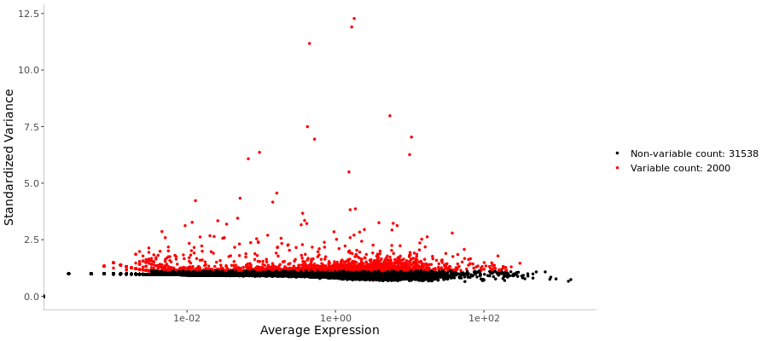
Feature selection
Quantification
QC
Data processing
QC
Biology
integration
Select the most variable, expressed genes across cells.
Focus on the biological signal.
Remove noise.
srat_obj <- FindVariableFeatures( object = srat_obj,
selection.method = 'vst',
nfeatures = 2000 )
Notes:
This is where we try and identify the most interesting genes in our experiment and to do this we use the most variant genes. Seurtat will report the top 2000 variant genes after variant stabilization of the expression values at the low count end. This has been shown to be a good number and playing around with this appears to have little effect on the analysis.

Slide 16
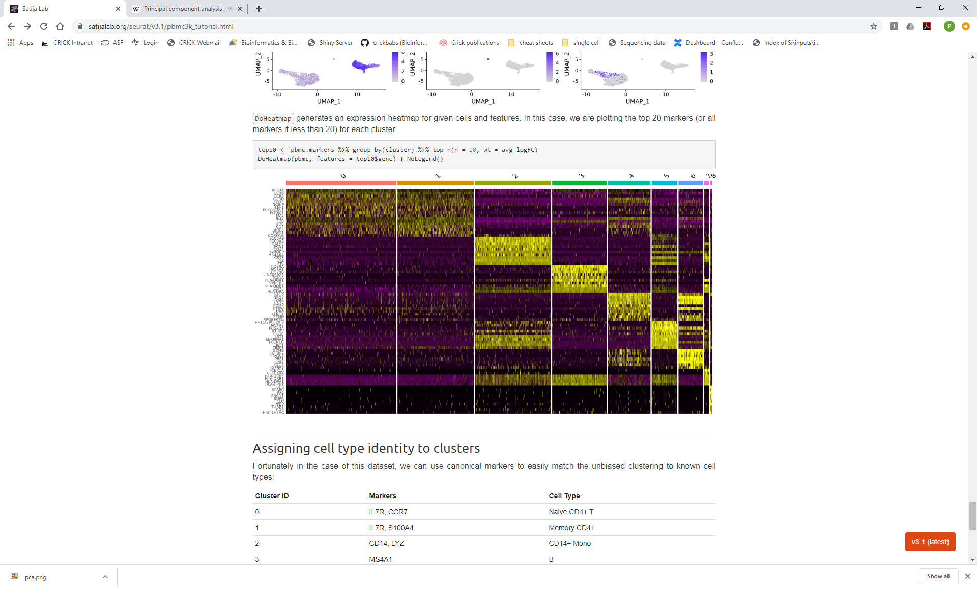
Dimension Reduction
Quantification
QC
Data processing
QC
Biology
integration
4000 cells
Remove correlated data
Reduce noise
Increase stability
Computationally more efficient
2000 genes
Notes:
Here we use PCA to reduce the dimensionality of our data. PCA first finds the linear path through the data that explains the largest variance. It then identifies the next path that explains the largest variance that is orthogonal to the first and so on. These paths or components can be thought of as representing sets of correlated or orchestrated genes across the cells. Why do we do this, well removing correlated data can help to reduce noise which makes the analysis more stable and it helps with the computation when working with large cell sets.

Slide 17
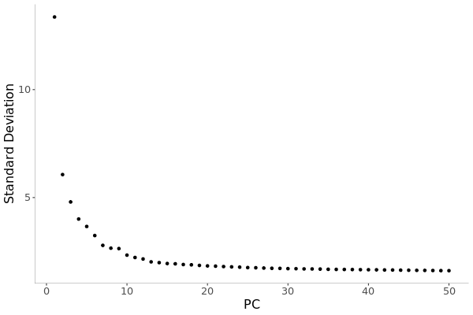
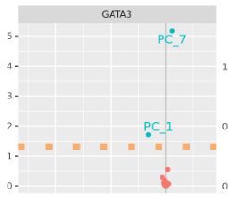
PCA
Quantification
QC
Data processing
QC
Biology
integration
How many principle components are relevant?
srat_obj <- RunPCA( srat_obj, npcs = 50 )
Notes:
How many PCs are relevant in my data. There are technics for trying to identify these. The most straightforward is to plot the percentage of variance explained by each PC and then try and identify the elbow in the plot. To be honest in most scRNASeq datasets, particularly when you have a heterogeneous set of cells with many different active transcriptional programmes an elbow is not easily identified.

Slide 18
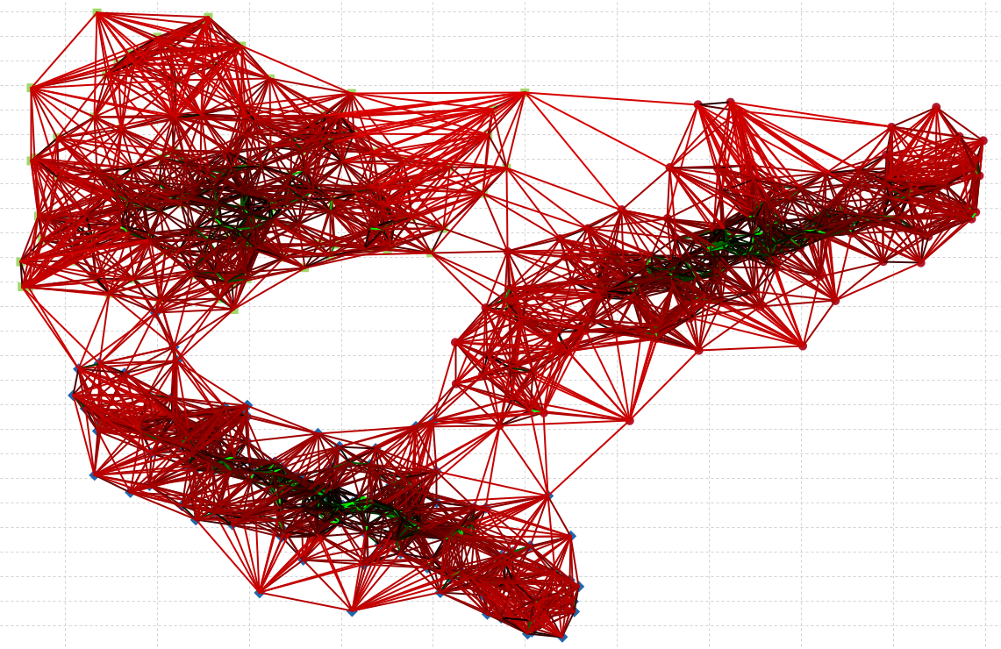
Clustering
Quantification
QC
Data processing
QC
Biology
integration
K nearest neighbour (KNN) graph approach
Edges are drawn between cells with similar expression patterns in PCA space.
Edges are then weighted based on shared overlap with neighbouring cells (Jaccard similarity)
The graph is partitioned into highly connected communities of cells.
Louvain algorithm

Slide 19
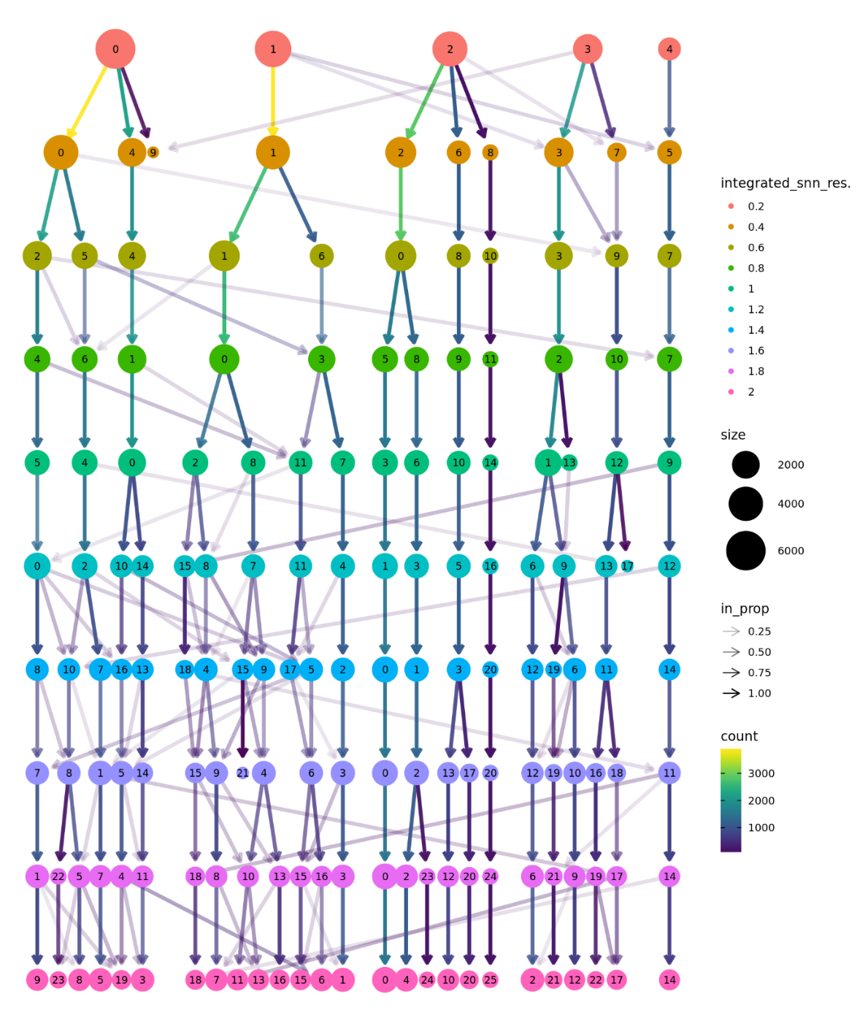
Clustering II
Quantification
QC
Data processing
QC
Biology
integration
pbmc <- FindNeighbors(pbmc, dims = 1:10)
pbmc <- FindClusters(pbmc, resolution = 0.5)
resolution
Cluster granularity.
Higher resolution -> more clusters.
0.4 -> 1.2 are typical values.
library( clustree )

Slide 20
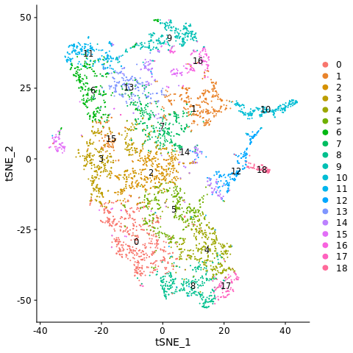
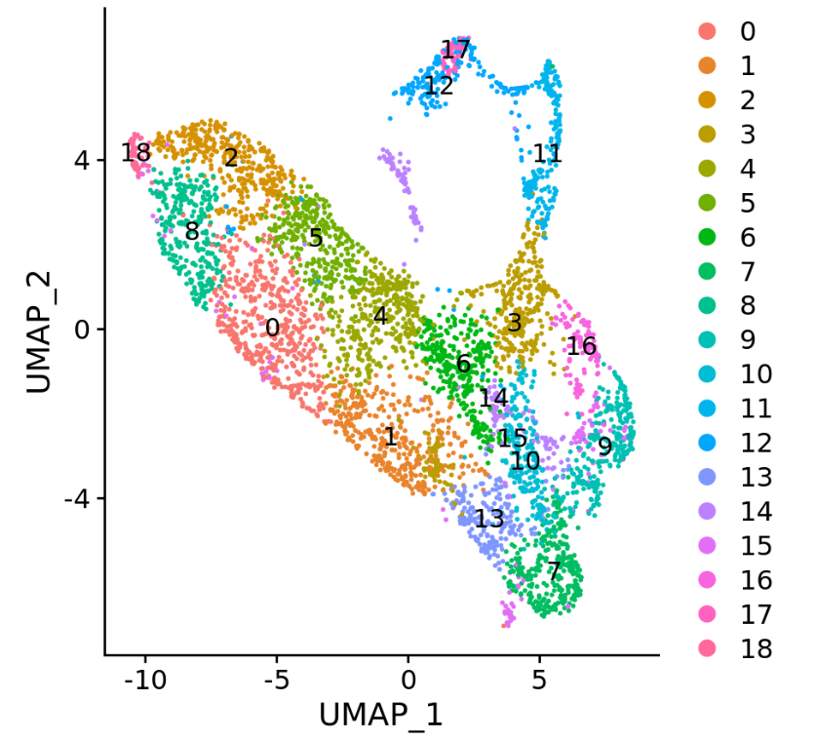
Projection
Quantification
QC
Data processing
QC
Biology
integration
Run non-linear dimensional reduction (UMAP/t-SNE)
2D projection of our highly dimensional data.
T-SNE
UMAP

Slide 21
Data analysis
Quantification
QC
Data processing
QC
Biology
integration
Marker genes
QC
Gene / molecule counts
Mitochondrial expression
Doublets
Cell cycle correction
Cluster identification
Differential gene analysis

Slide 22
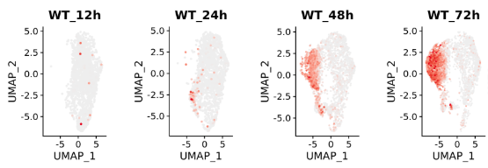
Marker genes
Quantification
QC
Data processing
QC
Biology
integration
Positive controls
Cell type classification
Trajectory anchors
Marker genes don’t always work
Expression too low
Transcript/protein mis-match
Markers not known

Slide 23
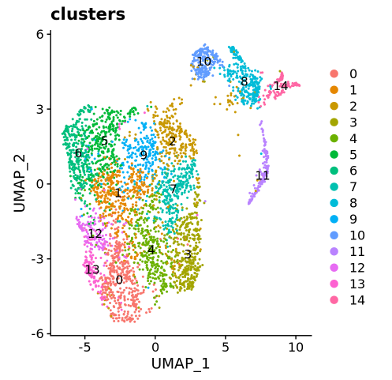
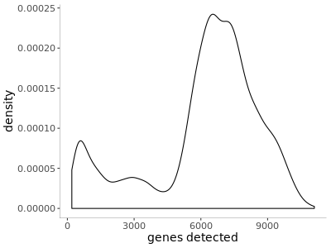
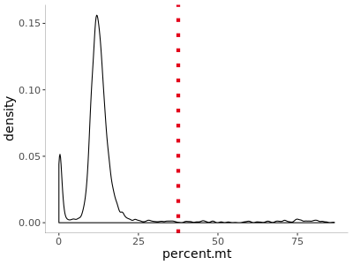
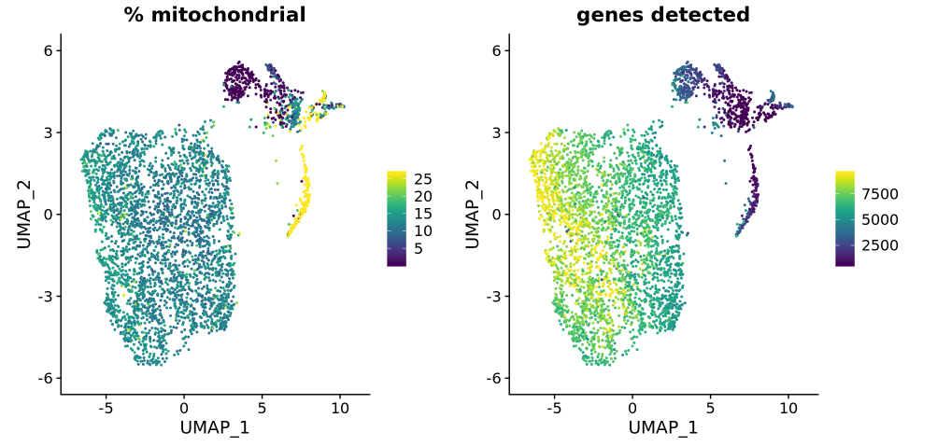
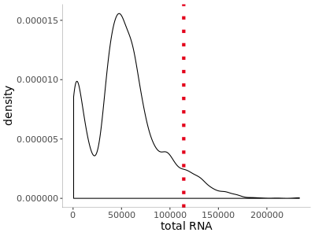
Analysis QC
Quantification
QC
Data processing
QC
Biology
integration
Genes detected
Some low count cells sneak through the cell caller
Mitochondrial expression
Mitochondrial expression is enriched in apoptopic cells due to the loss of cytoplasmic transcripts
Total expression
Unusually high total expression can indicate doublets.
Notes:
It is not always obvious where to apply thresholds to these distributions, since natural values may vary depending on the cell type. Therefore it is a good idea to take a cluster approach.

Slide 24
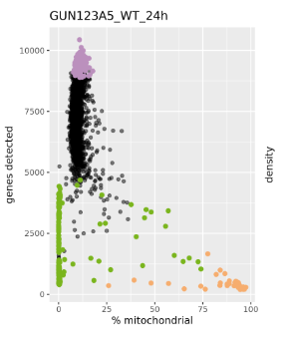
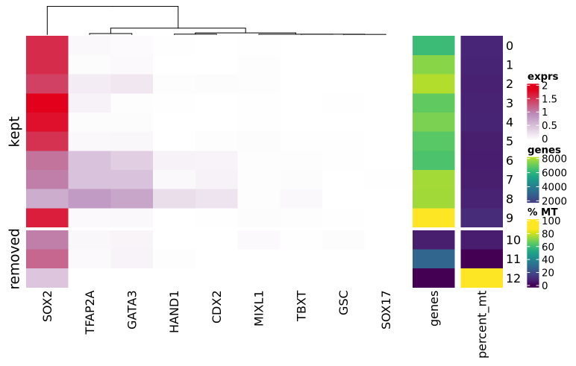
Analysis QC Mitochondrial expression
Quantification
QC
Data processing
QC
Biology
integration
Genes detected vs % mitochondrial
Assess clusters across a panel of marker genes

Slide 25
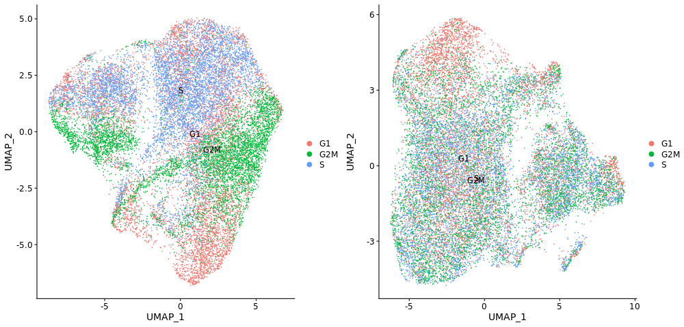
Cell cycle
Quantification
QC
Data processing
QC
Biology
integration
Score cell cycle with S and G2M gene-sets.
Regress
s.genes <- cc.genes$s.genes
g2m.genes <- cc.genes$g2m.genes
srat_clean_l <- CellCycleScoring( s.features = s.genes,
g2m.features = g2m.genes )
sobj <- ScaleData( sobj, vars.to.regress = c("S.Score", "G2M.Score") )
Notes:
Cell cycle expression is a problem in single cell experiments. It is possible to label cells as to where they are in the cell cycle using Seurat and it is then possible to regress out this effect. Now to apply this correction or not will depend on the experiment and must be used with caution. Many developmental processes are inherently correlated with the cell cycle and you want to be sure you are not regressing out the effect you are looking for. A close look at the principle components before and after can help here.

Slide 26
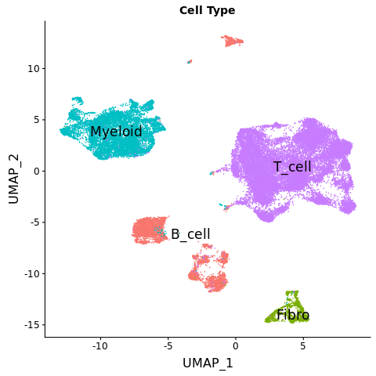
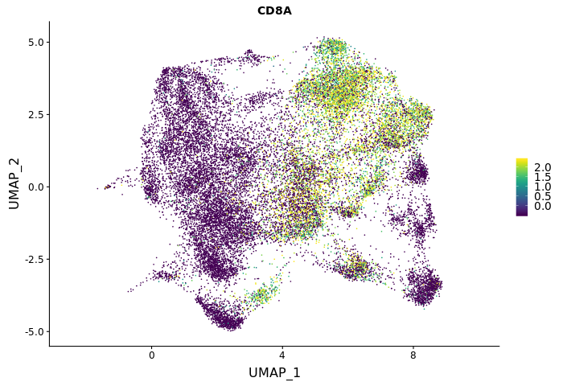
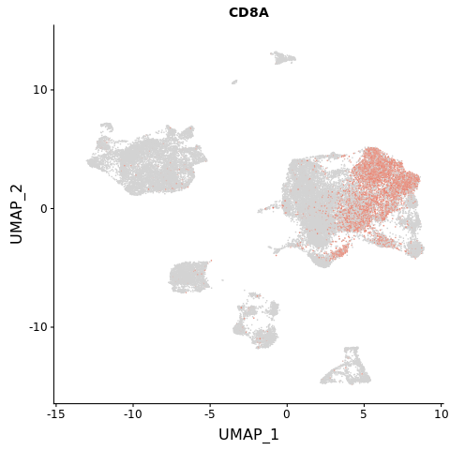
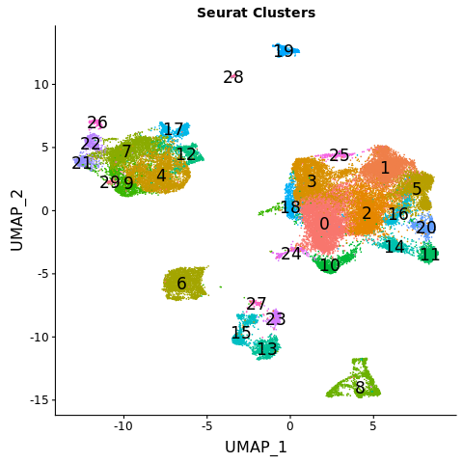
Cluster characterisation
Quantification
QC
Data processing
QC
Biology
integration
Lambrechts et. al. Nat Med.
Marker gene approach
CD8A expression
Resolution = 0.8
Notes:
How do we define cell types. Here I am using a lung cancer immune infiltrate dataset. Here are the published labels but if we look at this data blind with a clustering resolution of 0.8 this is the pattern we get. So to define clusters we first take a marker gene approach and here I am interested in identifying CD8+ t-cells.

Slide 27
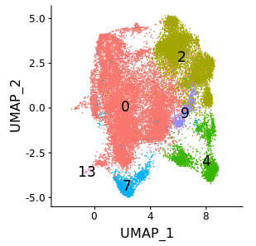
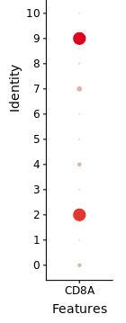
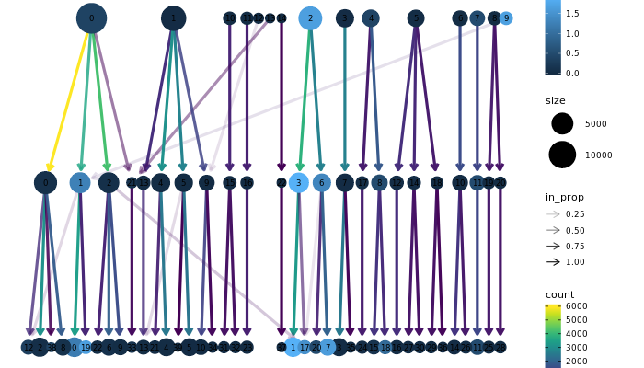
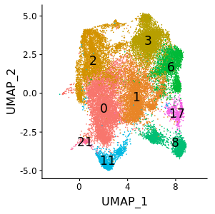
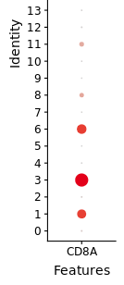
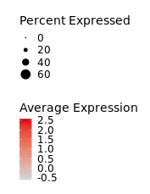
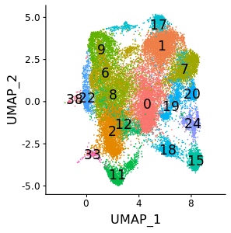
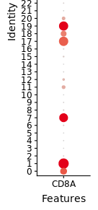
Cluster characterisation II
Quantification
QC
Data processing
QC
Biology
integration
CD8A expression
resolutions
0.2
0.4
1.2
Notes:
So now it is a case of mapping the expression to the clusters. Here we see the breakdown of the clusters by resolution again with CD8A expression highlighted.

Slide 28
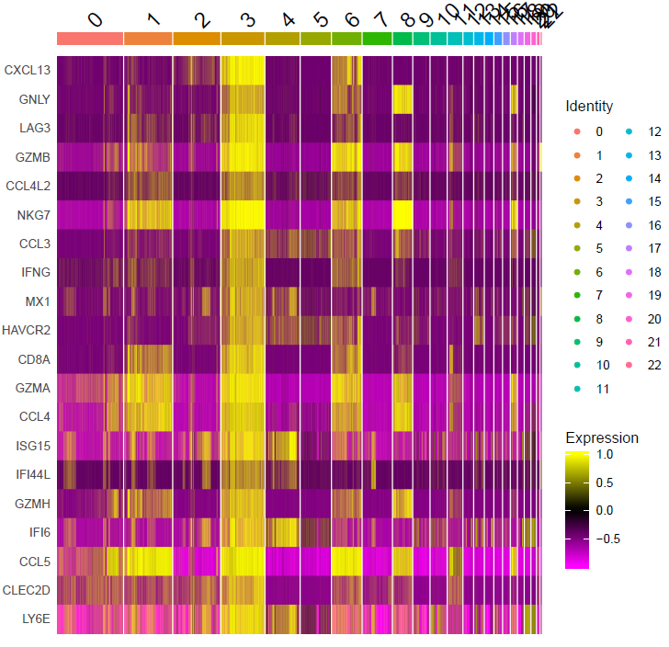
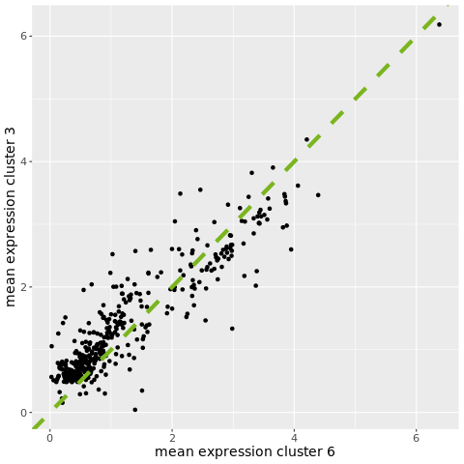
Differential analysis
Quantification
QC
Data processing
QC
Biology
integration
markers_all <- FindAllMarkers( srat_obj, min.pct = 0.25, logfc.threshold = 0.25 )
markers_clust_3 <- FindMarkers( srat_obj, ident.1 = 3, min.pct = 0.25, logfc.threshold = 0.25 )
Cluster three specific expression
Notes:
To further characterise our cells we can run a differential gene analysis across the clusters. We might be interested in identifying which genes are unique to our high density CD8A cluster no 3.

Slide 29
scRNA-Seq analysis overview
Integration (optional)
Quantification
QC
Data processing
QC
Biology
Alignment
Deconvolution
Cell / UMI
barcodes
Quantification
Cell count
Gene count
Read count
Signal to noise
Saturation
Normalisation
Feature selection
Dimension reduction
Clustering
t-SNE/UMAP
Low count cells
Doublets
Mitochondrial
Cell characterisation
Differential analysis
Notes:
This is an overview of the analysis process. We have quantification or the construction of the expression matrix across cells, we have a QC step, we then have an optional integration step if you are working with multiple libraries, we then have data processing where standard analysis steps are applied, further QC and then finally onto answering the biological question at hand.

Slide 30
Bioinformatics mini-series
Part1: An Introduction to scRNA-Seq Data Analysis.
Part2: Ordering Cells: Pseudo-time and Trajectory Building
16th September Richard Mitter
Future instalments
Data Integration across multiple sets of cells & multiple species
Cell characterisation and atlas datasets
scATAC-Seq Analysis
Correcting for systematic effects
Notes:
We already have part II. Richard Mitter is going to cover Pseudo-time analysis and we have these possible future topics lined up.

